Slide 1


Real-Time Emotion and Facial Expression Detection
Facial expressions are a powerful means of nonverbal communication, conveying a wealth of information about our emotional state, intentions, and social interactions. Automated facial expression recognition systems have a wide range of applications, from understanding human behavior and diagnosing mental disorders to enhancing human-machine interaction and creating more engaging entertainment experiences. This project explores the use of deep learning techniques to build a robust system capable of accurately identifying the seven universal emotions: anger, disgust, fear, joy, sadness, surprise, and neutrality.
by BHUVAN MADHUSUDHAN

Slide 2

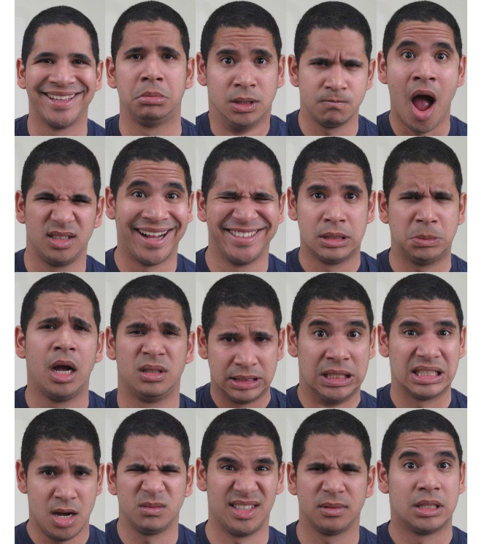
The Importance of Facial Expressions
Emotional Insight
Facial expressions provide a window into our emotional state, allowing us to better understand the feelings and intentions of those around us. This information is crucial for effective communication and social interaction.
Behavioral Analysis
By analyzing facial expressions, we can gain valuable insights into human behavior, which has applications in fields such as psychology, marketing, and security.
Human-Machine Interaction
Incorporating facial expression recognition into human-machine interfaces can enhance the user experience and enable more natural and intuitive interactions.

Slide 3

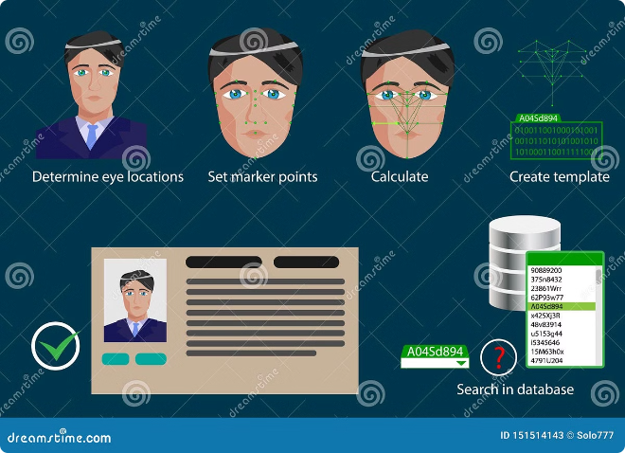
Facial Expression Recognition Techniques
1
Face Detection
The first step in facial expression recognition is to locate and isolate the face within an image or video frame.
2
Feature Extraction
Facial features, such as the shape and movement of the eyes, eyebrows, and mouth, are extracted and analyzed to identify the underlying emotional state.
3
Expression Classification
The extracted features are then used to classify the facial expression into one of the seven universal emotions, using advanced machine learning algorithms.

Slide 4
The Emotion FER Dataset
Dataset Description
Dataset Composition
Data Preprocessing
The Emotion FER dataset consists of 48x48 pixel grayscale images of faces, with each image labeled with one of the seven universal emotions.
The dataset includes 28,709 training examples and 7,178 test examples, providing a robust and diverse set of data for model training and evaluation.
The faces in the images have been automatically registered and centered, making the dataset well-suited for deep learning-based facial expression recognition.

Slide 5

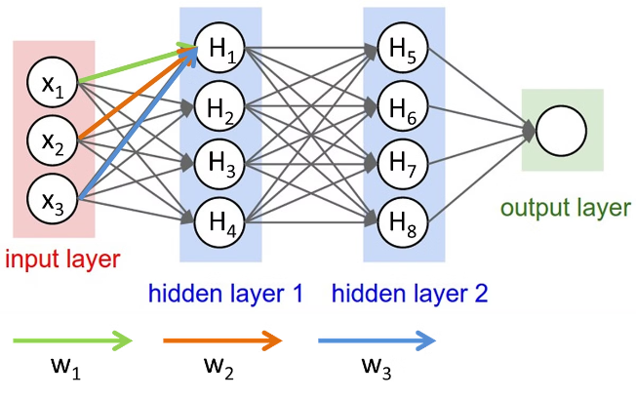
Convolutional Neural Network (CNN) Model
1
Model Architecture
The model consists of 4 convolutional layers and 2 fully connected layers, designed to effectively extract and classify facial features.
2
Optimization and Training
The model is trained using the Adam optimizer and categorical cross-entropy loss function, with accuracy as the evaluation metric.
3
Model Saving and Serialization
The trained model is saved in a JSON format, allowing for easy deployment and integration into a real-time facial expression recognition system.

Slide 6


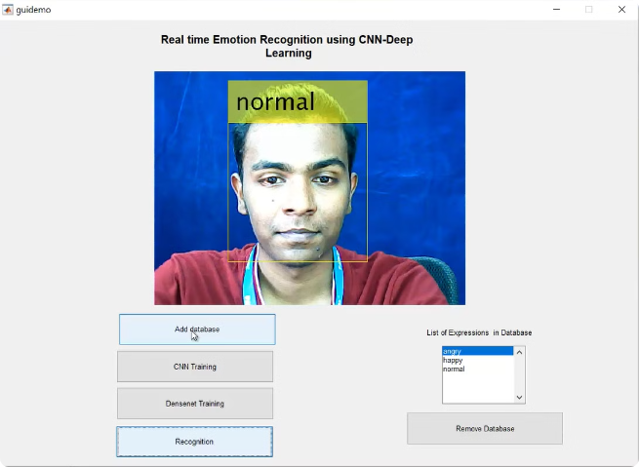


Real-Time Facial Expression Recognition
Webcam Capture
The system captures real-time video from the user's webcam, continuously analyzing the facial expressions of the person in front of the camera.
Facial Expression Classification
The pre-trained CNN model is used to classify the detected facial expressions into one of the seven universal emotions in real-time.
Web Interface Display
The recognized facial expressions are displayed on a web interface, providing a user-friendly and interactive experience.

Slide 7



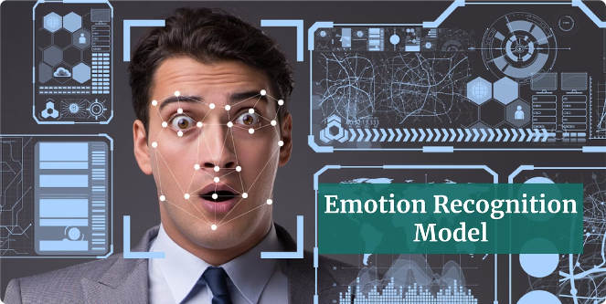


Applications of Facial Expression Recognition
Retail
Retailers can use facial expression recognition to assess customer interest and engagement, optimizing their marketing strategies and product offerings.
Healthcare
Healthcare providers can leverage facial expression recognition to better understand patient mood and emotional state, leading to more personalized and effective care.
Entertainment
Entertainment producers can monitor audience engagement and reactions in real-time, allowing them to create more impactful and engaging content.
Psychology
Facial expression recognition can provide valuable insights for psychological research and the diagnosis of mental health conditions.

Slide 8

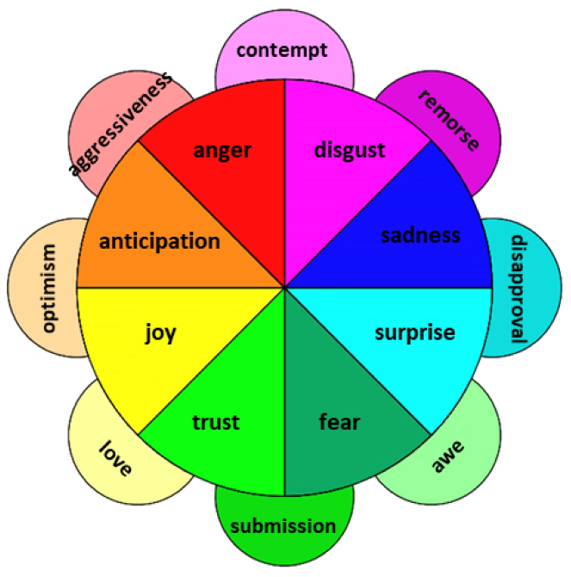
Challenges and Future Developments
Accuracy Improvement
Continued research and development of more advanced deep learning algorithms can further enhance the accuracy of facial expression recognition systems.
Real-Time Performance
Optimizing the computational efficiency of the models and leveraging hardware acceleration can enable real-time facial expression recognition on a wider range of devices.
Robustness to Variations
Addressing challenges such as varying lighting conditions, head poses, and occlusions can improve the reliability of facial expression recognition in real-world scenarios.
Ethical Considerations
Addressing privacy concerns and ensuring the responsible use of facial expression recognition technology will be crucial as the field continues to evolve.

Slide 9

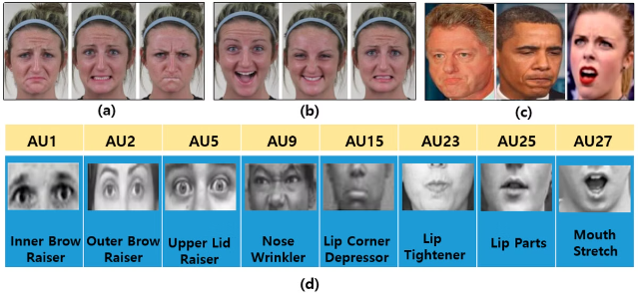
Conclusion
Facial expression recognition is a rapidly advancing field with a wide range of applications, from enhancing human-machine interaction to providing valuable insights for psychology and healthcare. This project has demonstrated the power of deep learning techniques in building a robust system capable of accurately identifying the seven universal emotions in real-time. As the technology continues to evolve, we can expect to see even more innovative and impactful applications of facial expression recognition in the years to come.

Slide 10


References
Coursera Project-Based Course Overview
Kaggle Tutorial: Facial Expression Classification with Keras
Fundamentals of Facial/Emotion Recognition

